Slide 1
iCARe An Intelligent Car Budgeting Assistant
Group 4 Members:
Muniyandi Vanitha, A0249302L
Sim Yuh Fan, A0249251E
Tan Gek Teng, A0030151E
Teoh Jeng Wei, A0093899B

Slide 2
Agenda
Project Goals
Project Timeline
Wireframe Design
System Architecture
Data Collection and Preparation
Data Exploration
Dimension Reduction with PCA
Forecasting Models
Next Steps

Slide 3
Project Goals
Problem Statement
In recent years, the COE prices in Singapore have been skyrocketing due to high inflation, low COE quotas and high demand for private vehicles. Predicting future COE prices in this environment is not an easy task and the fear of increasing prices induces the average consumer to make potentially rash financial decisions.
How are we going to solve the problem?
Our objective is to build an application which will predict future COE prices and recommends a list of cars based on the user's budget and target purchase date to help users to make informed financial decisions.
Scope
There are 5 COE categories - CAT A,B,C,D,E. However, for this project, we will be focussing on CAT A COE price forecasting as a MVP

Slide 4
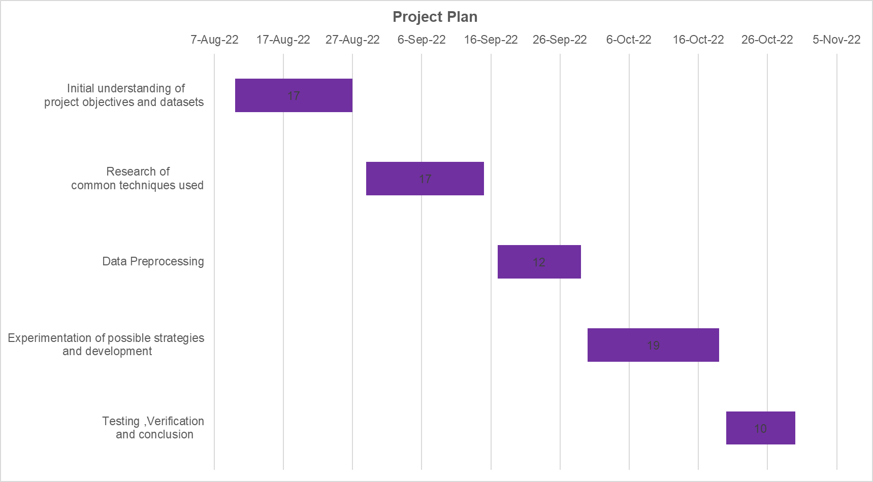
Project Timeline

Slide 5
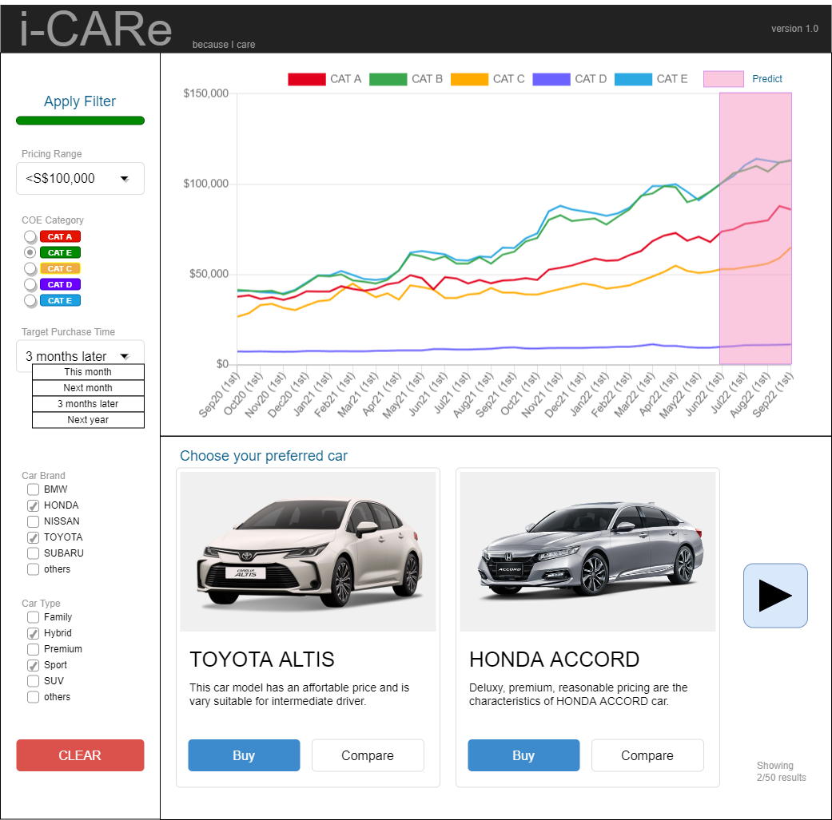
Wireframe design
3 components
1) COE price forecast
2) User input
3) List of recommended cars

Slide 6
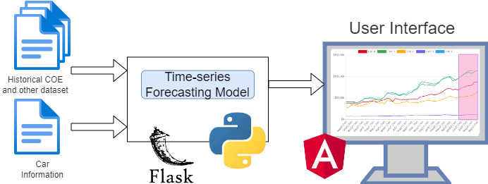
System Architecture

Slide 7
Data Collection and Preparation
The COE dataset (base dataset) and other datasets which might help in our prediction are collected:
Dataset | Description | Frequency | Year
COE | COE Bidding Result for Vehicle Category A to E | Bi-monthly | 2002 – 2022
Household Income | Average and Median Monthly Household Income from Work Among Resident and Resident Employed Households (per household and per household member) | Yearly | 2000 - 2021
GDP | Gross Domestic Product At Current Market Prices and By Industry | Yearly | 1960 - 2021
Public Transport | Public Transport Operation And Ridership (Bus, MRT, LRT) | Yearly | 1990 - 2021
PDI | Personal Disposable Income and Personal Saving | Quarterly | 1980 – 2022
Household Net Worth | Household Net Worth, Assets and Liabilities | Quarterly | 1995 – 2022
CPI | Consumer Price Index and Inflation Rates | Monthly | 1990 – 2022
Oil Price | Crude Oil WTI Futures Data | Weekly | 2002 – 2022
Notes:
WTI stands for West Texas Intermediate (occasionally called Texas Light Sweet), an oil benchmark that is central to commodities trading.
Oil futures are contracts in which you agree to exchange an amount of oil at a set price on a set date. They’re traded on exchanges and reflect the demand for different types of oil. Oil futures are a common method of buying and selling oil, and they enable you to trade rising and falling prices.

Slide 8
Data Collection and Preparation
As the datasets are of different frequencies and date range we have decided on the following strategies to clean and merge the datasets into one master dataset for subsequent use:
In the base COE dataset, assign the first and second bidding result to 1st and 15th of each month respectively
Upsample datasets with yearly, quarterly or monthly frequencies to bi-monthly (1st and 15th of each month) and fill the missing values using the same value within the same year, quarter or month
Downsample datasets with weekly frequencies to bi-monthly taking the first entry that is closest to the 1st and 15th of each month
Merge the datasets using a ‘left join’ to the base COE dataset

Slide 9
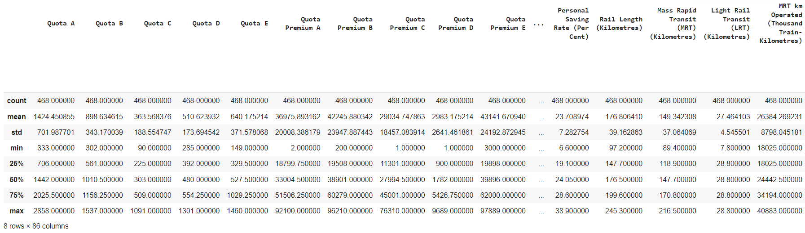
Data Exploration
The resulting merged (master) dataset contains 468 rows and 86 columns

Slide 10
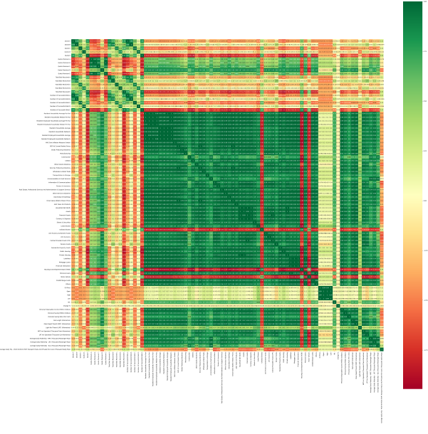
Data Exploration
The pairwise correlation heatmap shows that there are quite a number of highly correlated features which suggest that we could apply dimension reduction as our next step

Slide 11
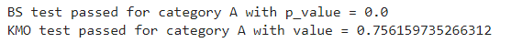
Dimension Reduction with PCA
Barlett’s Sphericity (BS) test & Kaiser-Meyer-Olkin (KMO) test were conducted to find out whether the dataset is suitable for PCA and the result shows that both the tests are passed.

Slide 12
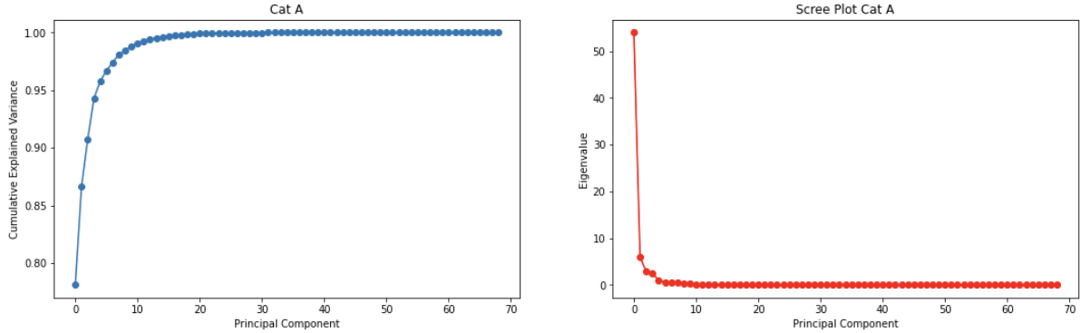
Dimension Reduction with PCA
The resulting plots shows that around 6 - 10 principal components can be used to explain approximately 96% - 98% of the variance.

Slide 13
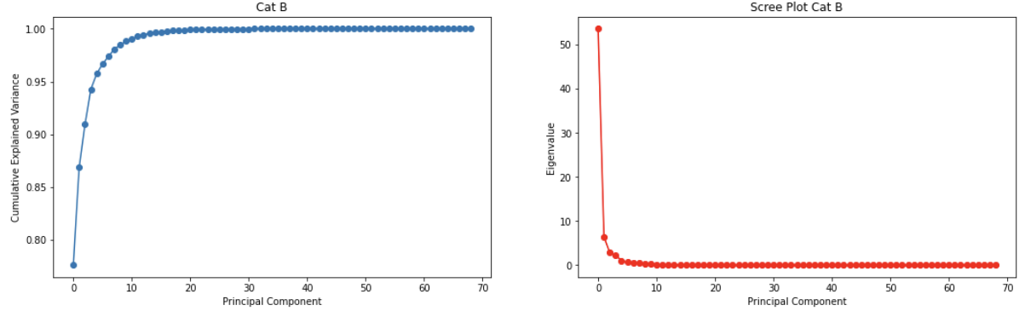
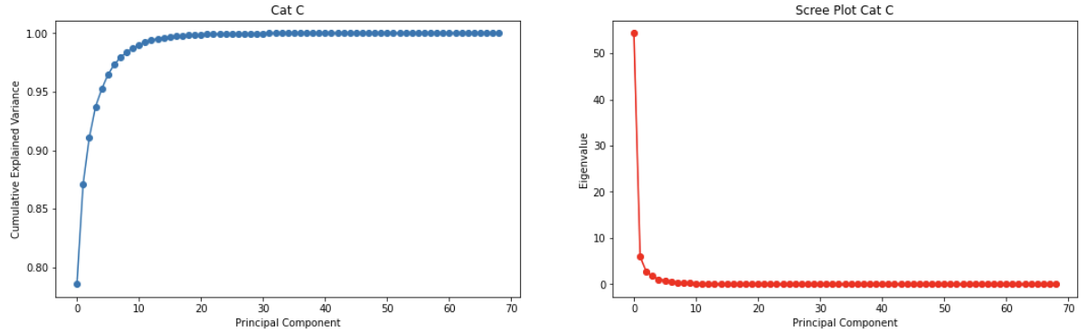
Dimension Reduction with PCA

Slide 14
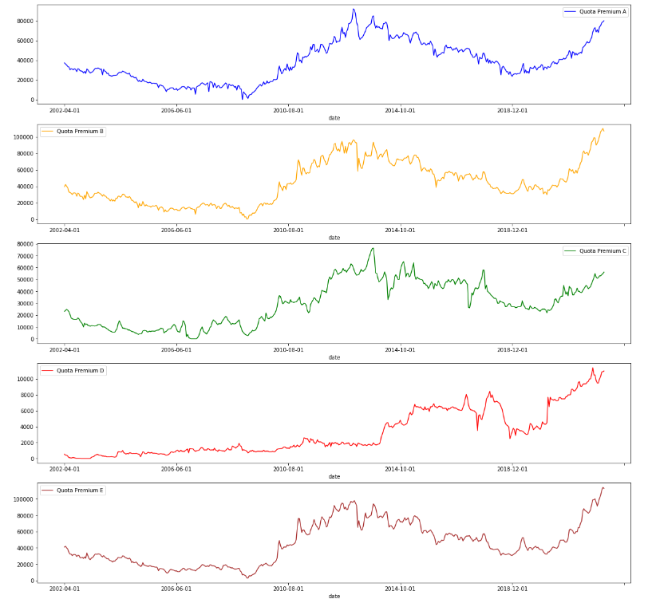
Forecasting Models
Time Series Forecasting Algorithms:
ARIMA
LSTM
CNN
Performance Metrics
Mean Absolute Error (MAE)
Root Mean Square Error (RMSE)
Mean Absolute Percentage Error (MAPE)

Slide 15
Single-Variate ARIMA
Baseline model
The Autoregressive Integrated Moving Average (ARIMA) model is a combination of the differenced autoregressive model with the moving average model.
An ARIMA model is characterized by 3 terms: p, d, q
p is the order of the AR term
q is the order of the MA term
d is the number of differencing required to make the time series stationary
Training the model to forecast 2 years ahead -> the last 48 data points are taken from the time-series to be used as a testing set while the model is trained on the preceding 420 data points
Notes:
ARIMA Definition
https://www.sciencedirect.com/topics/mathematics/autoregressive-integrated-moving-average
https://www.machinelearningplus.com/time-series/arima-model-time-series-forecasting-python/

Slide 16
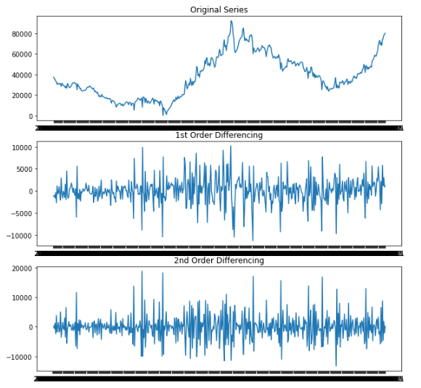
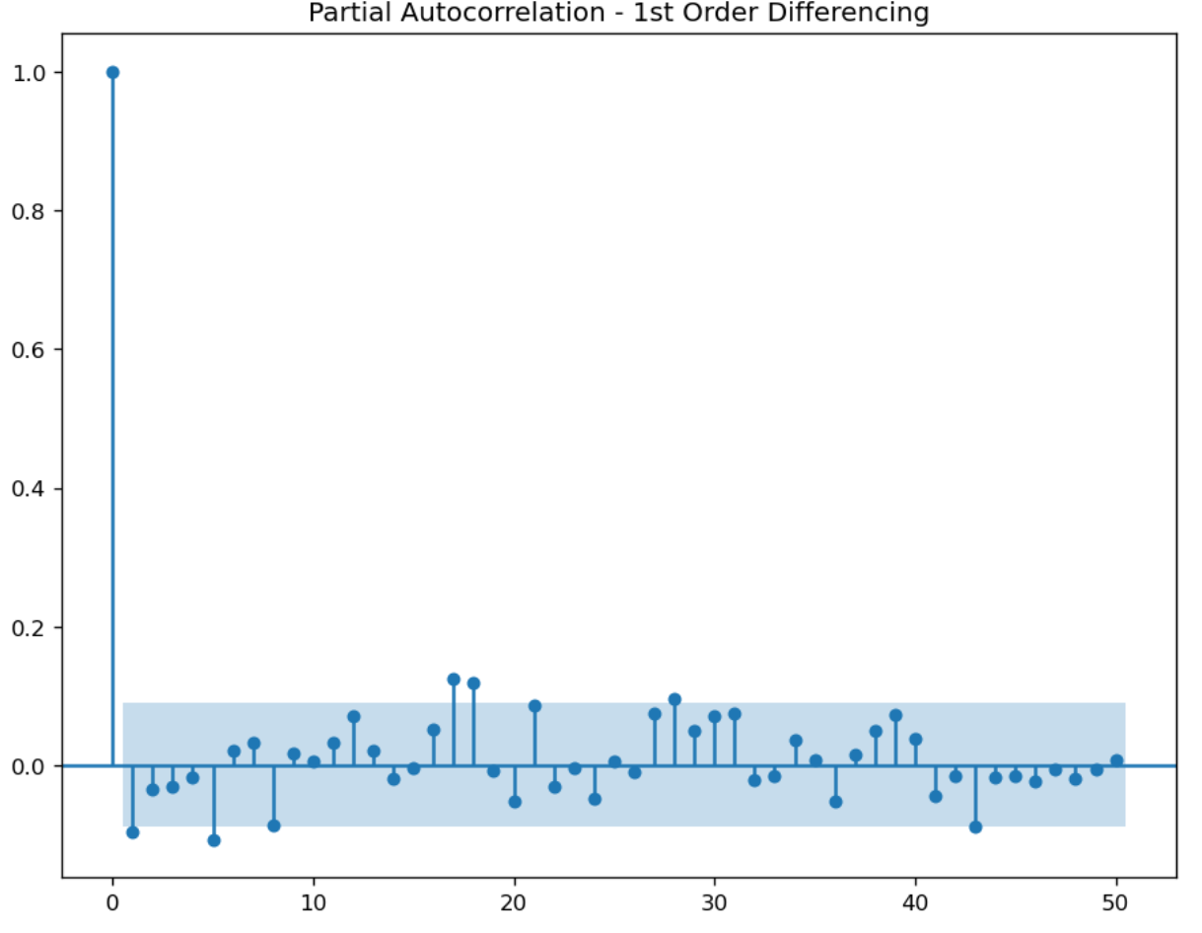
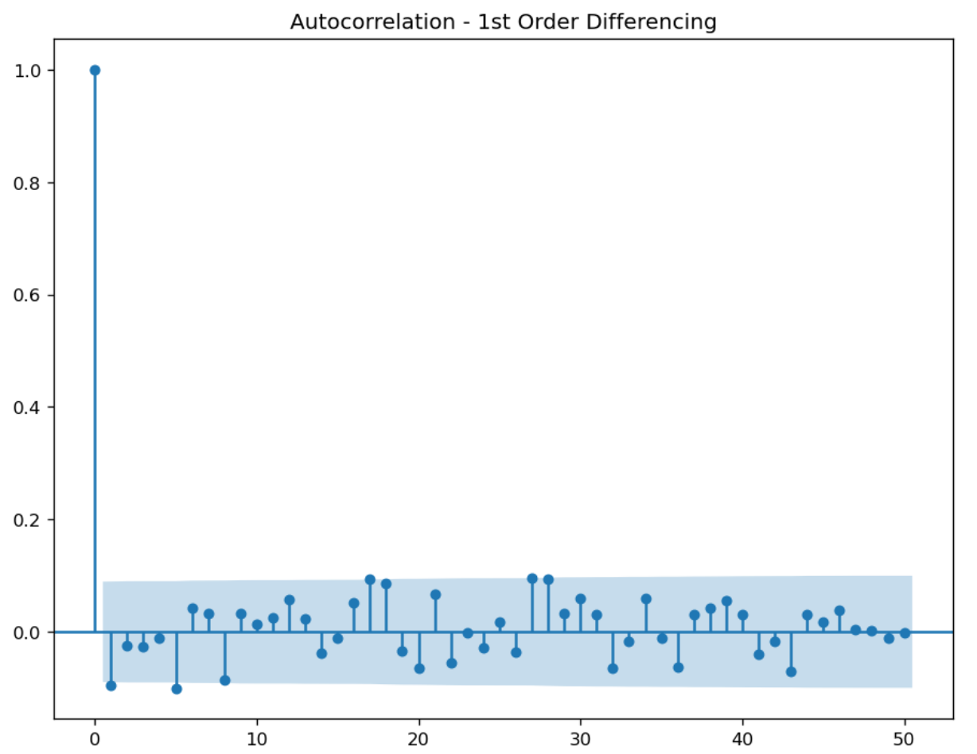
Single-Variate ARIMA
Estimating the values of p, d, q for COE CAT A ARIMA model
PACF lag 1 is significant since is below the significance line => p =1
2 of the ACF lags exceeded the significance line => q =2
Time-series data becomes stationary after 2 times of differencing => d=2
Notes:
ARIMA Definition
https://www.sciencedirect.com/topics/mathematics/autoregressive-integrated-moving-average
https://www.machinelearningplus.com/time-series/arima-model-time-series-forecasting-python/

Slide 17
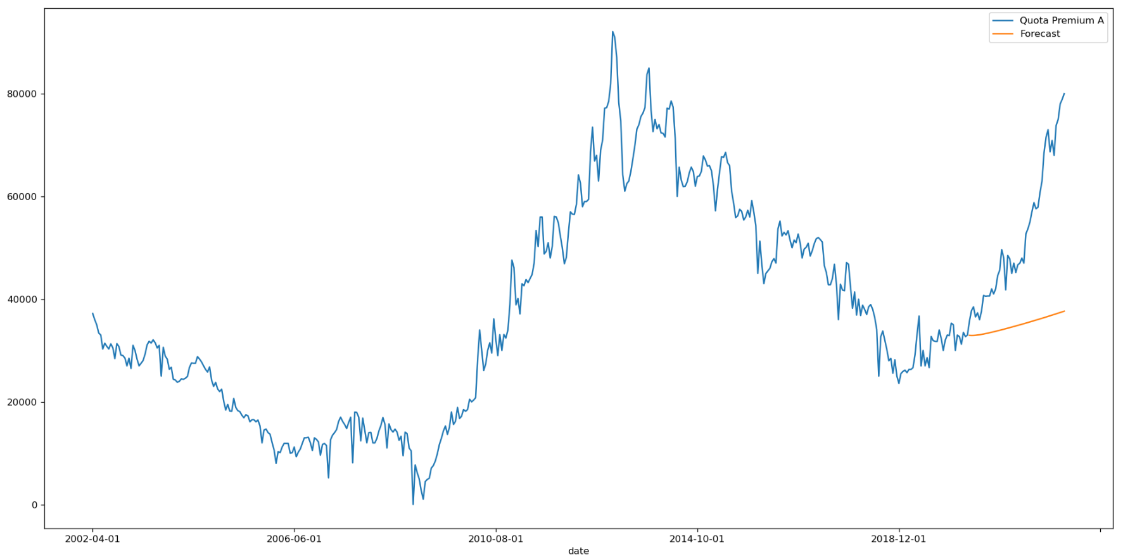
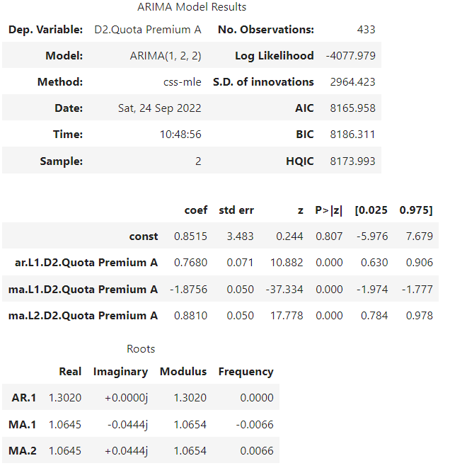
Single-Variate ARIMA
Parameters: p=1, d=2, q=2
Metric | Value
MAE | 21174.30
RMSE | 17583.81
MAPE | 29.56%
Forecast trend is in the correct direction but there is an increasing divergence between the actual and forecasted values
Attempts to refine the ARIMA model by trying out different combinations of p, d, q values did not yield any improvements
Set of values of (p,d,q) is good:
coef for AR1, MA1, MA2 are significantly high
P>|z| << 0.05 for all 3 elements
Notes:
ARIMA Definition
https://www.sciencedirect.com/topics/mathematics/autoregressive-integrated-moving-average
https://www.machinelearningplus.com/time-series/arima-model-time-series-forecasting-python/

Slide 18
Single-Variate SARIMA
If a time series, has seasonal patterns, then you need to add seasonal terms and it becomes SARIMA, short for ‘Seasonal ARIMA’.
A SARIMA model is characterized by 7 terms: p, d, q, P, D, Q and s
p and seasonal P is the order of the AR term
q and seasonal Q is the order of the MA term
d and seasonal D is the number of differencing required to make the time series stationary
s is the seasonal length in the data
Let P=p, Q=q and D=d
s can be estimated by determining the interval between the ACF lags that are significant -> there is a significant negative lag at 1 and 43 -> indicate that s=42
Training the model to forecast 2 years ahead -> the last 48 data points are taken from the time-series to be used as a testing set while the model is trained on the preceding 420 data points
Notes:
ARIMA Definition
https://www.sciencedirect.com/topics/mathematics/autoregressive-integrated-moving-average
https://www.machinelearningplus.com/time-series/arima-model-time-series-forecasting-python/

Slide 19
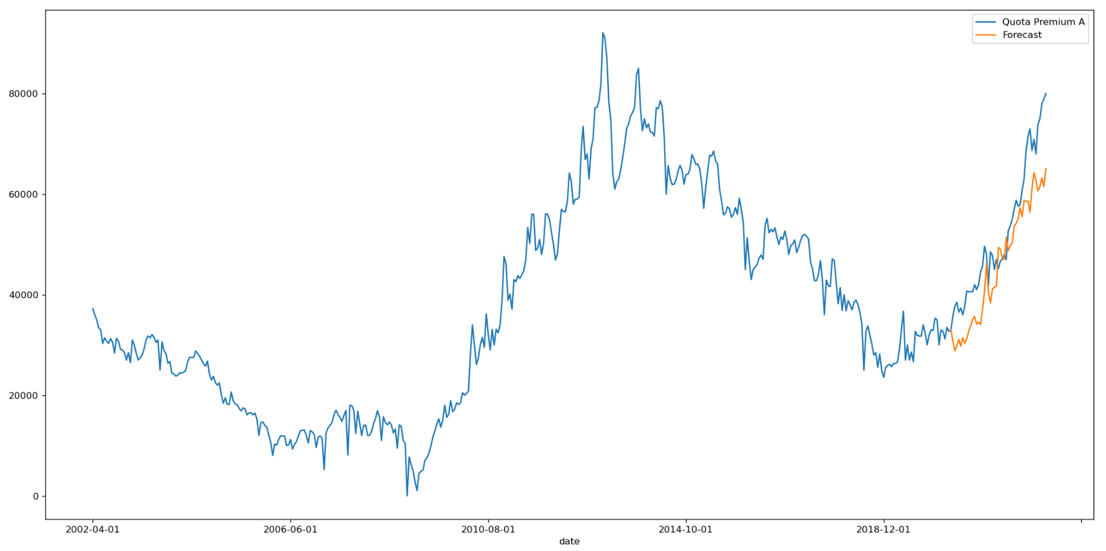
Single-Variate SARIMA
Parameters: p=1, d=2, q=2, P=1, D=2, Q=2, s=42
Metric | Value
MAE | 8064.11
RMSE | 6934.91
MAPE | 13.22%
Notes:
ARIMA Definition
https://www.sciencedirect.com/topics/mathematics/autoregressive-integrated-moving-average
https://www.machinelearningplus.com/time-series/arima-model-time-series-forecasting-python/

Slide 20
Model Comparison
Metric | ARIMA | SARIMA
MAE | 21174.30 | 8064.11
RMSE | 17583.81 | 6934.91
MAPE | 29.56% | 13.22%
SARIMA significantly outperforms ARIMA (MAPE of 13.22% vs 29.56%)
Notes:
ARIMA Definition
https://www.sciencedirect.com/topics/mathematics/autoregressive-integrated-moving-average
https://www.machinelearningplus.com/time-series/arima-model-time-series-forecasting-python/

Slide 21
Next steps
Train and Evaluate other models on CAT A COE prices:
Multivariate ARIMA, SARIMA
CNN, LSTM
Back-end and Front-end development
Application Testing

Slide 22
Queries
Is feature selection required if using deep learning model?

